Slide 1

MARIO GAME USING JAVASCRIPT
TEAM _ 06
Group members
2010030168 Tahseen begum
2010030165 Syed Reshma Banu
2010030129 Sai Geethika
2010030046 E. Pravallika

Slide 2
ABSTRACT
All this project “ Mario” game and it is a platform game, In the game, Mario must race through the Mushroom Kingdom and save Princess Toadstool from Bowser. Mario jumps runs and walks across each level. The worlds are full of enemies and platforms and open holes. This game is popular among children. This project aims to build a Mario game with JavaScript, HTML, and CSS. This game is built with the help of the visual studio using the concepts of basic Java Script.
This project aims to build a Mario game with Java Script, Mario is a series of platform games

Slide 3
IMPLEMENTATION (Steps to play game)
Learn the controls. On the original NES game, and in most remakes, the controls are A or B (A on NES) to jump, X or Y (B on NES) to run or shoot a fireball, the direction pad to move, holding X or Y (B on NES) whilst moving to dash, Start (+) to pause, and Select (-) to switch between Mario and Luigi in the title screen.
Jump on enemies. Often, this is the only way to defeat them. Koppas (the turtle-like creatures) and Buzzy Beetles will turn into a shell when jumped on. Hitting the shell will send it gliding. You will get extra points if it hits other enemies. Goombas can be defeated when stepped on, but you'll have to butt bounce if you have mini Mario. You can shoot fire at most enemies as well (and get a coin as a reward). However, shooting fire at Dry Bones has no effect. Step on Dry Bones to stun him for a short while.
Get a running start when making a jump. Sometimes, it is impossible to jump onto something without getting a fast start on your jump. Before jumping, the run-up to the object with B or Y on the Direction Pad.

Slide 4
Hit blocks. The levels in Super Mario have loads of blocks. Some blocks have question marks, which either have a coin, a red mushroom, a green 1UP mushroom, or a fire flower. A red mushroom makes you grow into Super Mario, and a fire flower lets you shoot fireballs at enemies, Coins are worth 200 points, and collecting 100 will give you a free 1UP, as will a green mushroom. Make sure to hit regular blocks also. Many contain nothing, but some have items or even several coins in them. Invisible blocks also exist, though they can be difficult to find. Some blocks have a vine to climb. So be careful which direction you choose to hit a block; it may be a vine leading to a secret pipe.
Look for shortcuts. To enter a pipe that leads to the underground, or underwater levels, is to simply press down on the Direction Pad while on top of a pipe. Going underground will often yield several coins and a shortcut. Another type of shortcut is the warp zone, which can advance you several levels (only for SMB speed runners)

Slide 5
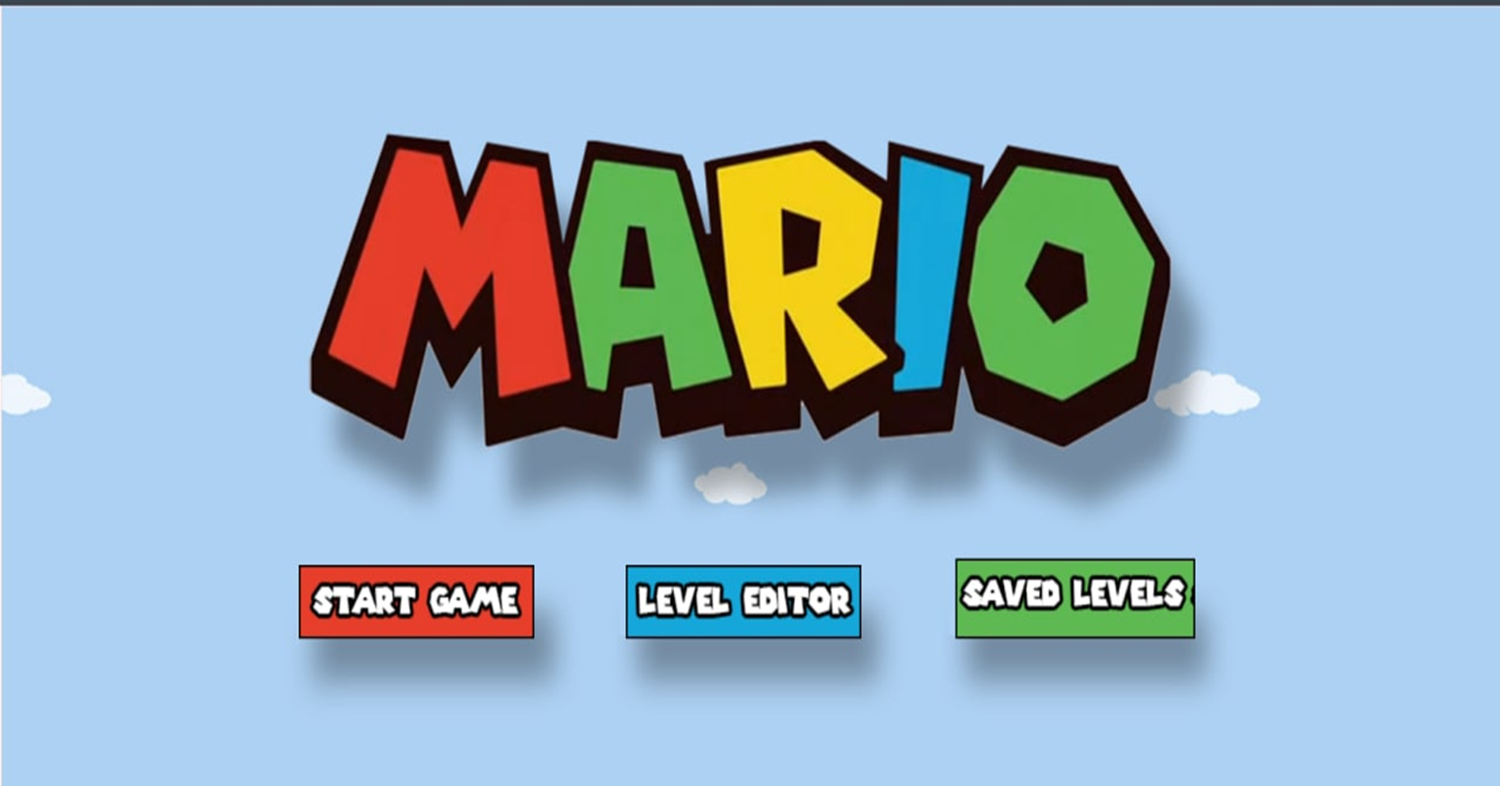
RESULT
Main page

Slide 6
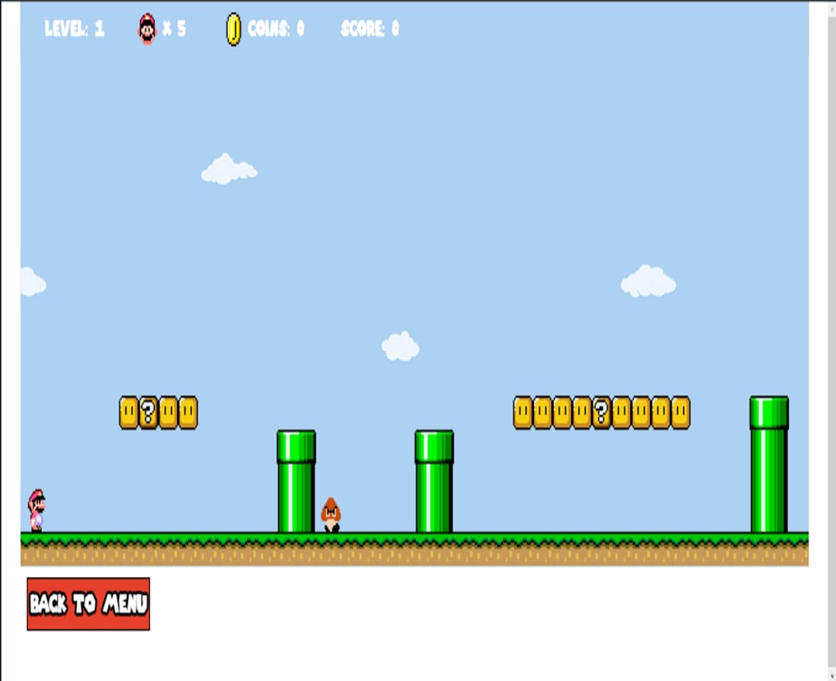
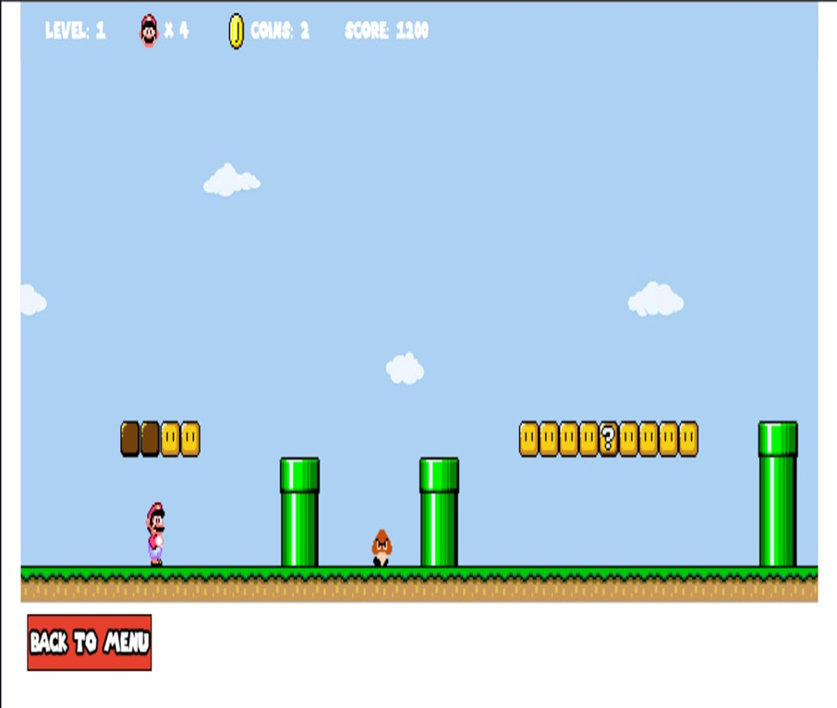
Start game

Slide 7
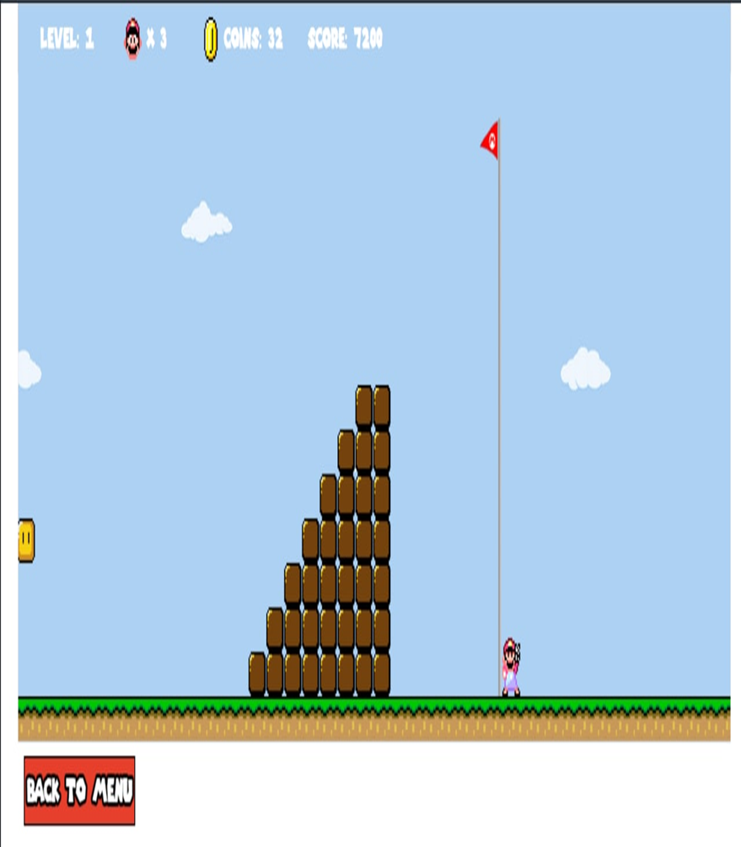
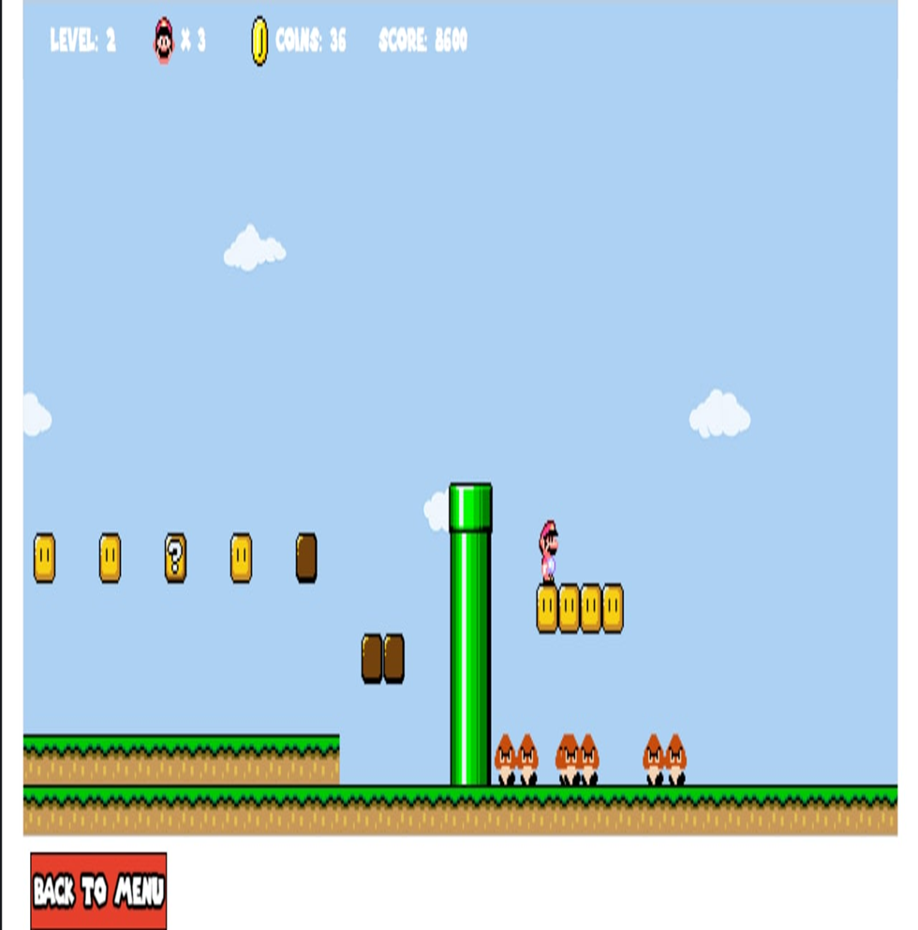
Clear 1 level, went to 2 level

Slide 8
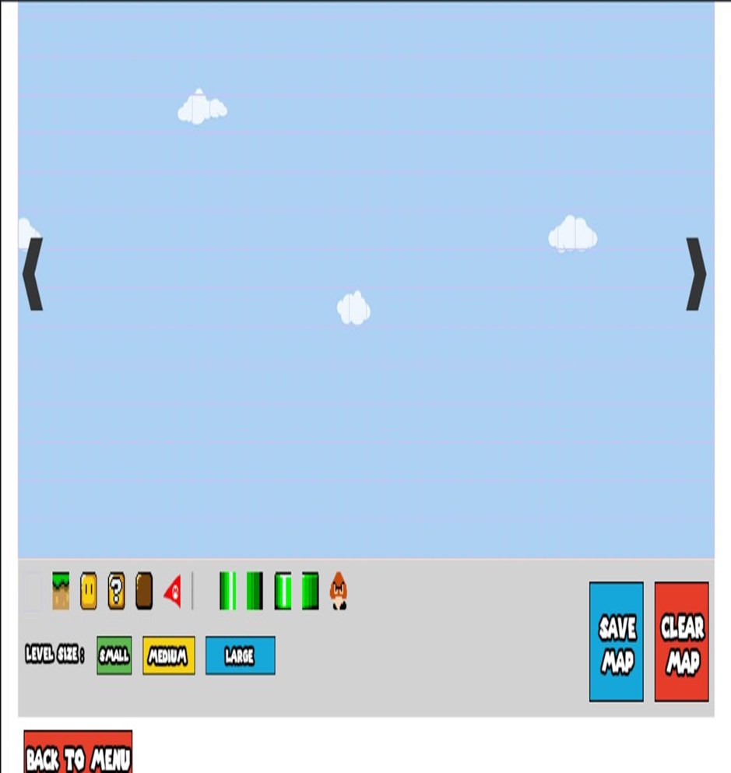
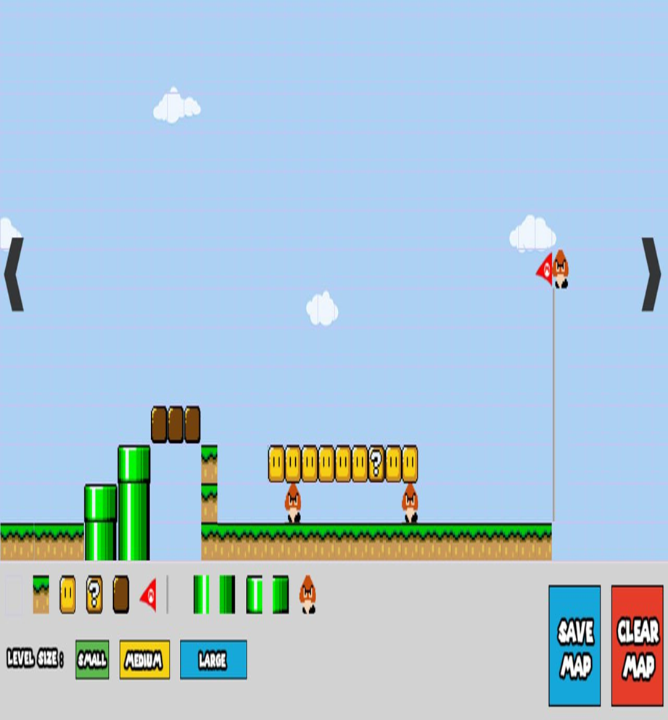
Edit game

Slide 9
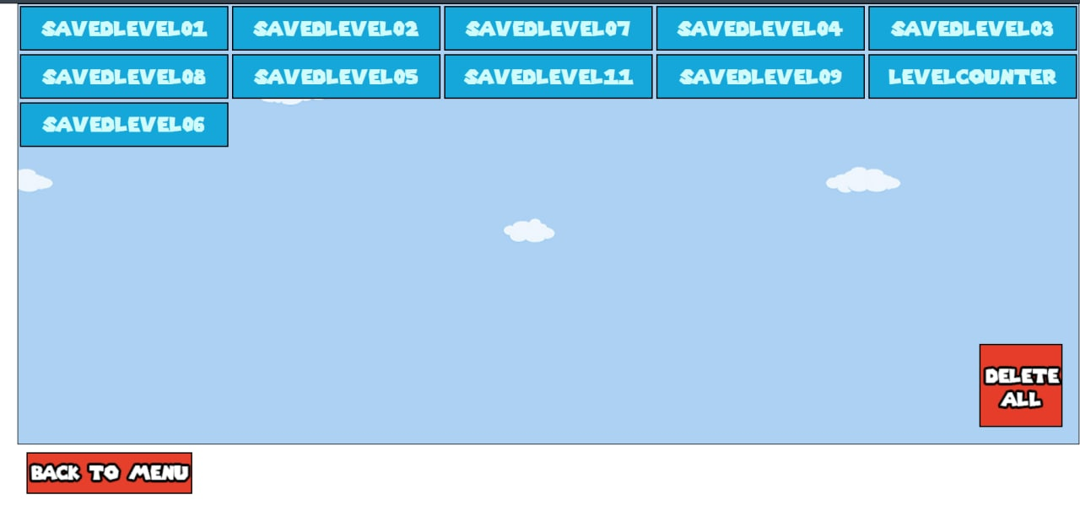
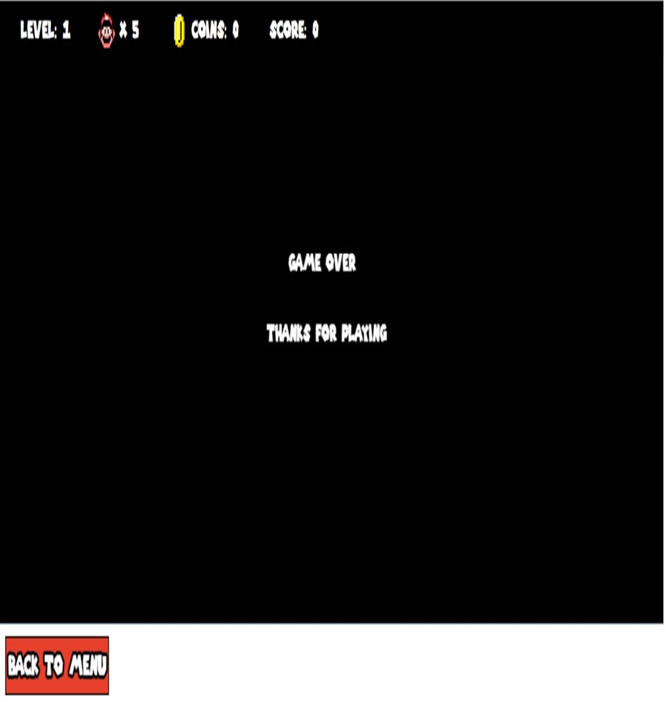
Edited levels Game over

Slide 10


